Slide 1
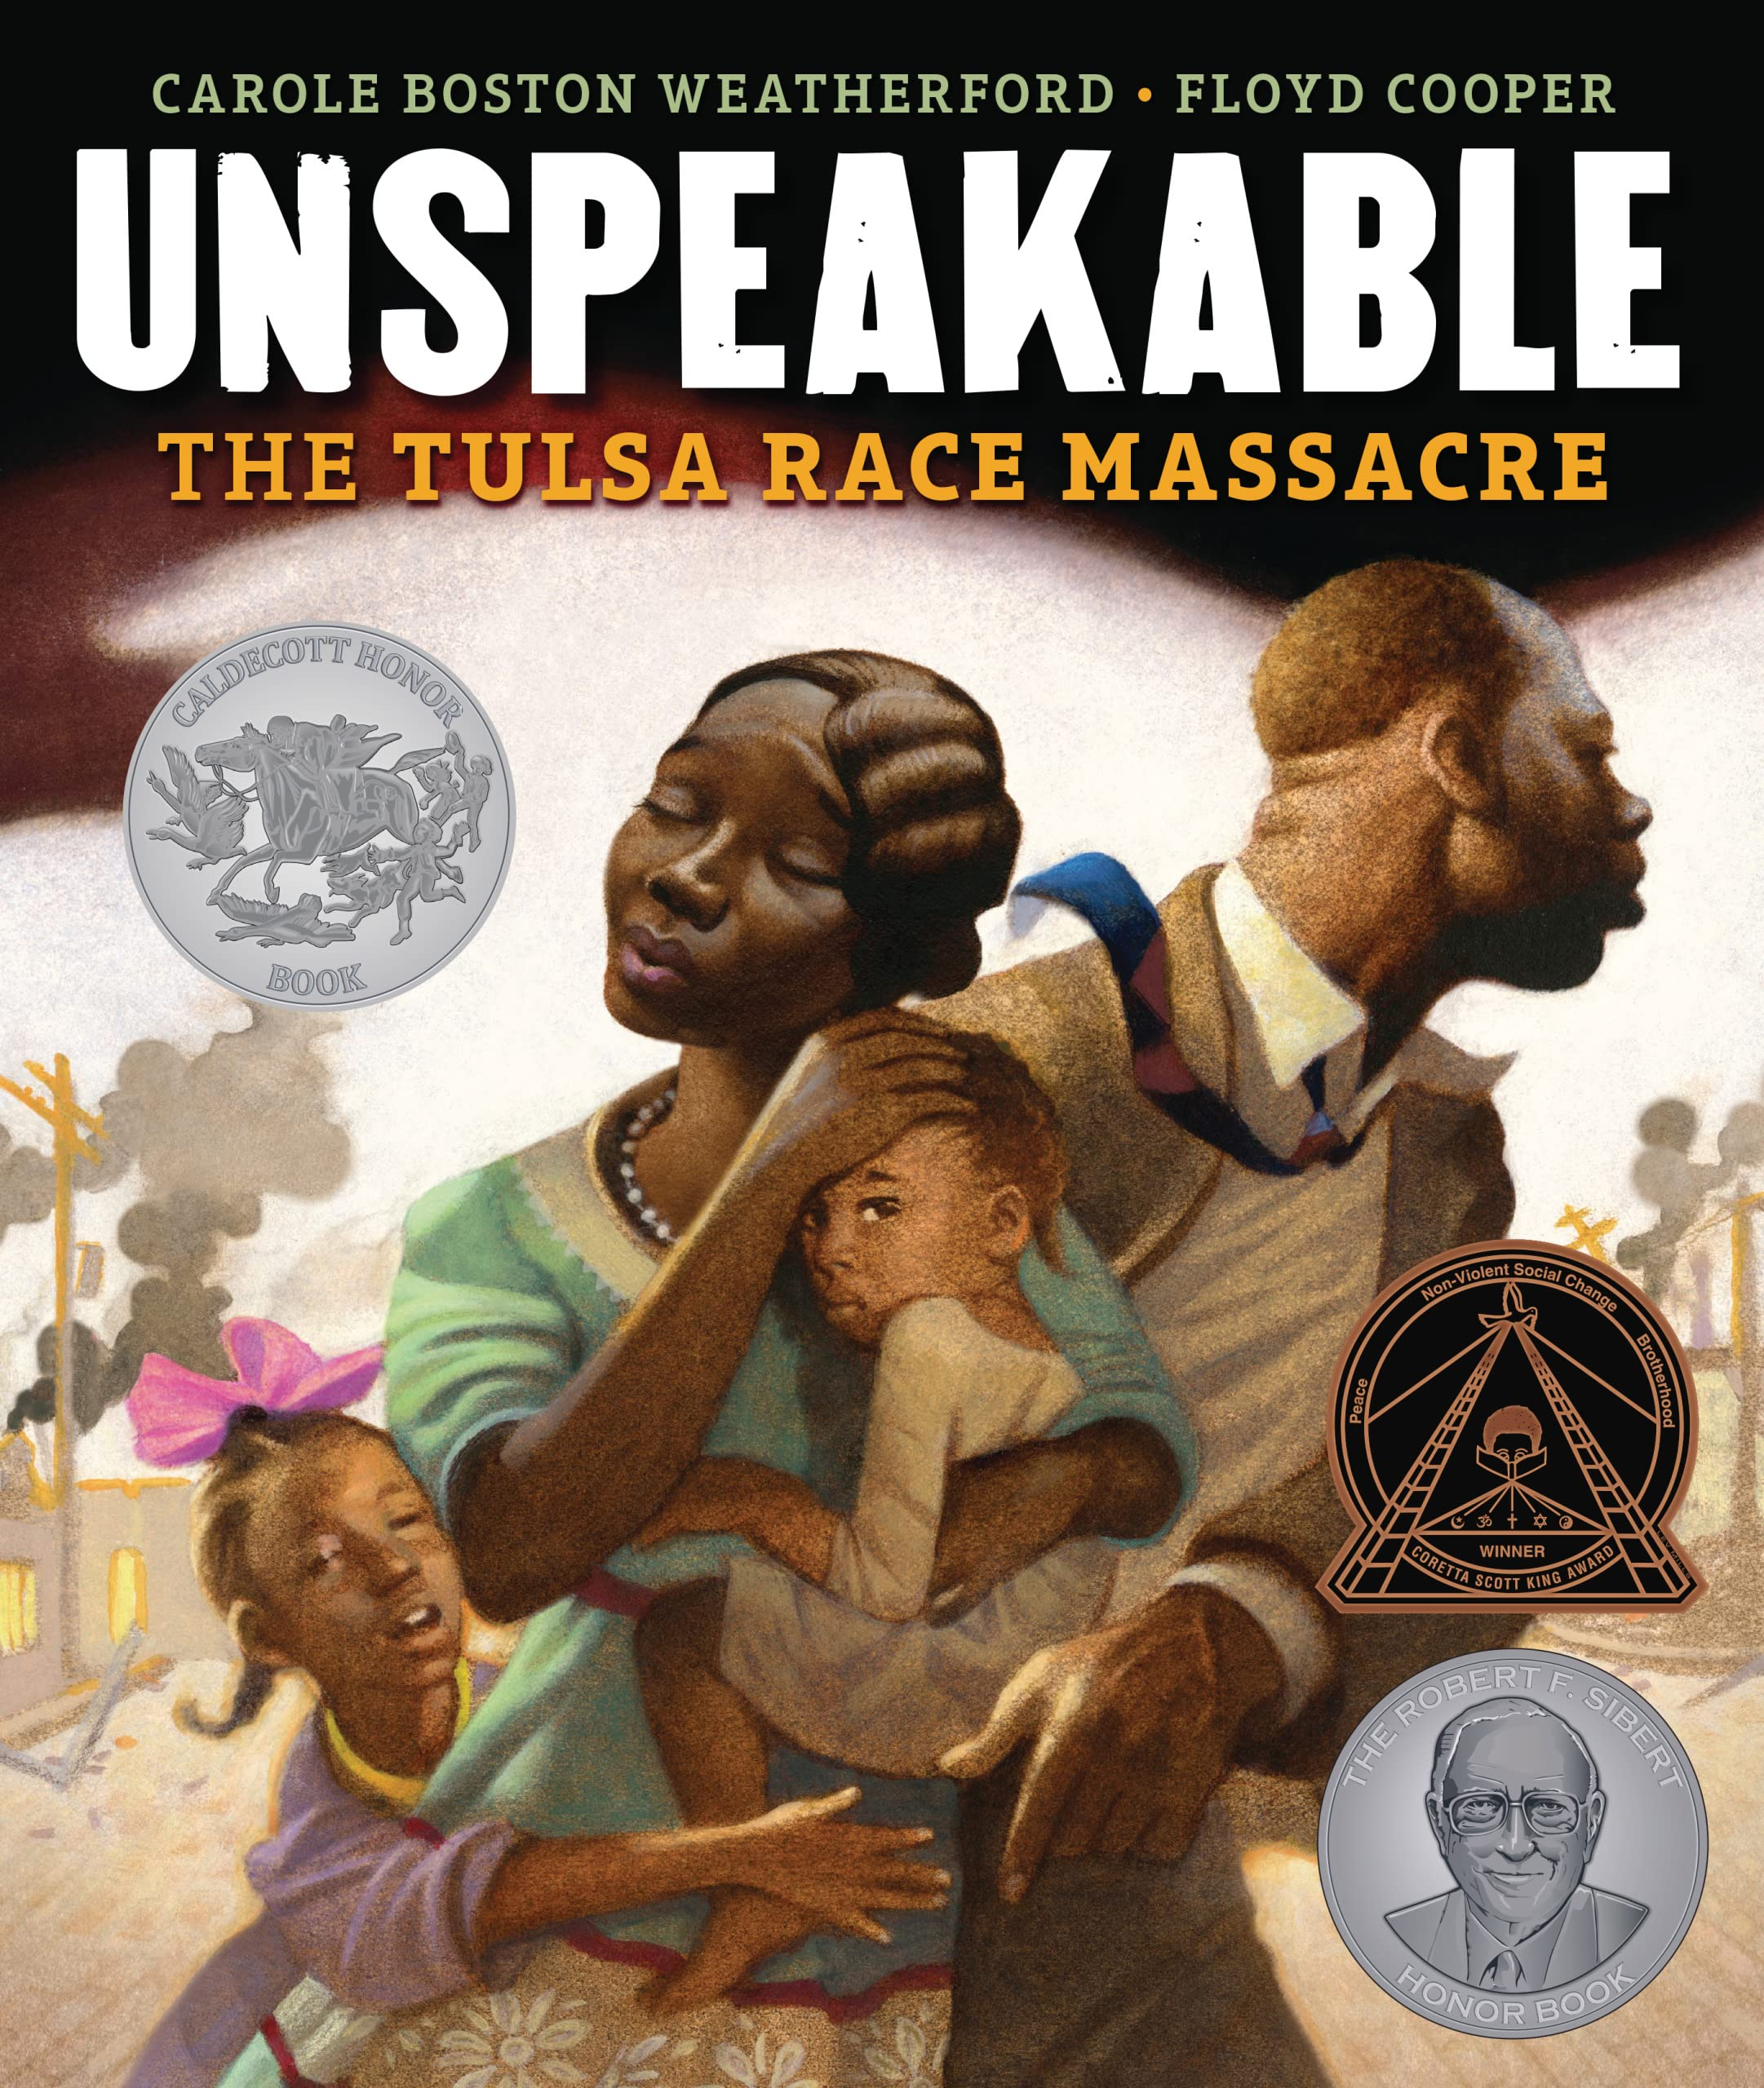
Unspeakable: The Tulsa Race Massacre
Student Health & Human Services
Office of Human Relations, Diversity & Equity
July 2022

Slide 2
Welcome
Would you rather read the book or watch the movie?
Book
Movie

Slide 3
Objectives
View the read-aloud for Unspeakable: The Tulsa Race Massacre
Review the history of Black Wall Street
Reflect on the implications of the Tulsa Race Massacre

Slide 4
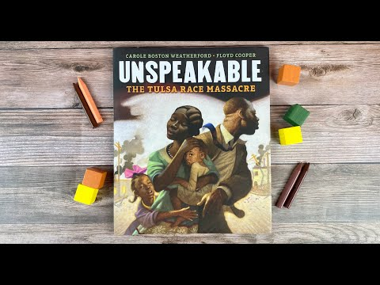
Read-A-Loud
Notes:
Play Video (9:26)
https://www.youtube.com/watch?v=RLcxfCPbz_U

Slide 5

Reflection
What comes up for you after hearing that story?

Slide 6
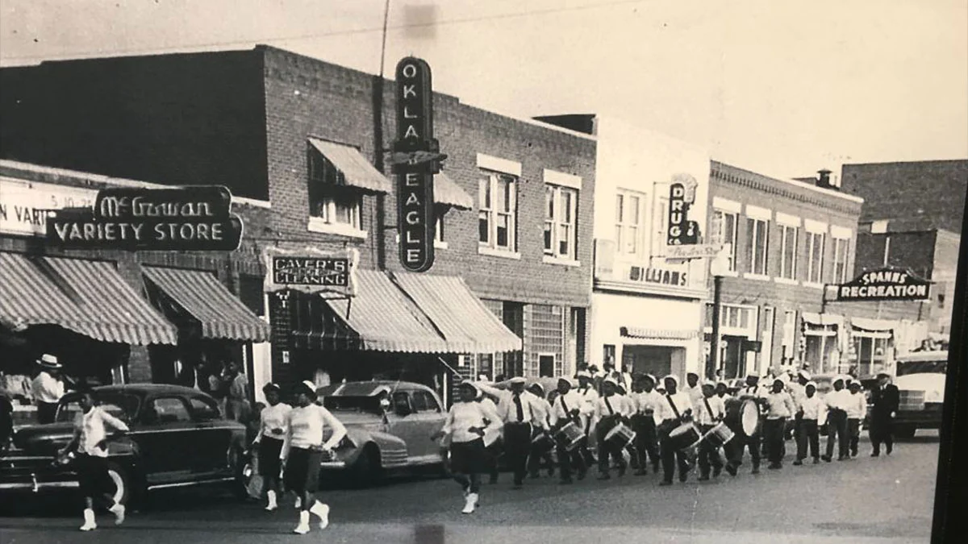
Black Wall Street
Due to Jim Crow Laws following the end of slavery, Black people were not permitted to go to white churches, hospitals, stores or restaurants.
Black folks in the Greenwood neighborhood of Tulsa worked together to build their own businesses.

Slide 7
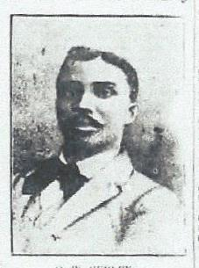
OW Gurley
Ottoway and Emma Gurley bought 40 acres in the Greenwood area of Tulsa.
Gurley opened the first businesses on Black Wall Street – a rooming house, 3 two-story buildings and 5 homes
Gurley loaned other Black people money to create their own businesses.
Notes:
Ottaway W Gurley and wife Emma moved to Tulsa and purchased 40 acres. Black Wall Street was built on these 40 acres.
Ottaway opened the first business on Black Wall Street – A rooming house – also built three two story buildings and five homes
He loaned other Black people money to create their own businesses

Slide 8
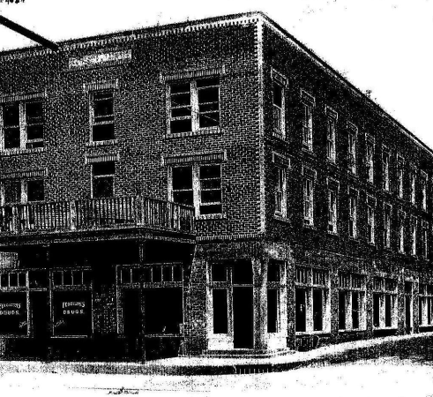
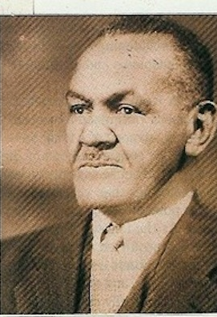
JB Stradford
JB Stradford and his wife Augusta moved to Tulsa and built a 54 room hotel.
The Stradford Hotel was the largest hotel owned by a Black man in the nation, at the time.
The hotel had a gambling hall, a dining room, saloon and a pool hall.
Notes:
JB Stradford and his wife Augusta moved to Tulsa and built a 54 room hotel in Greenwood
It was the largest hotel owned by a Black man in the couuntry at the time
-Gambling hall, dinig room, saloon and a pool hall.

Slide 9
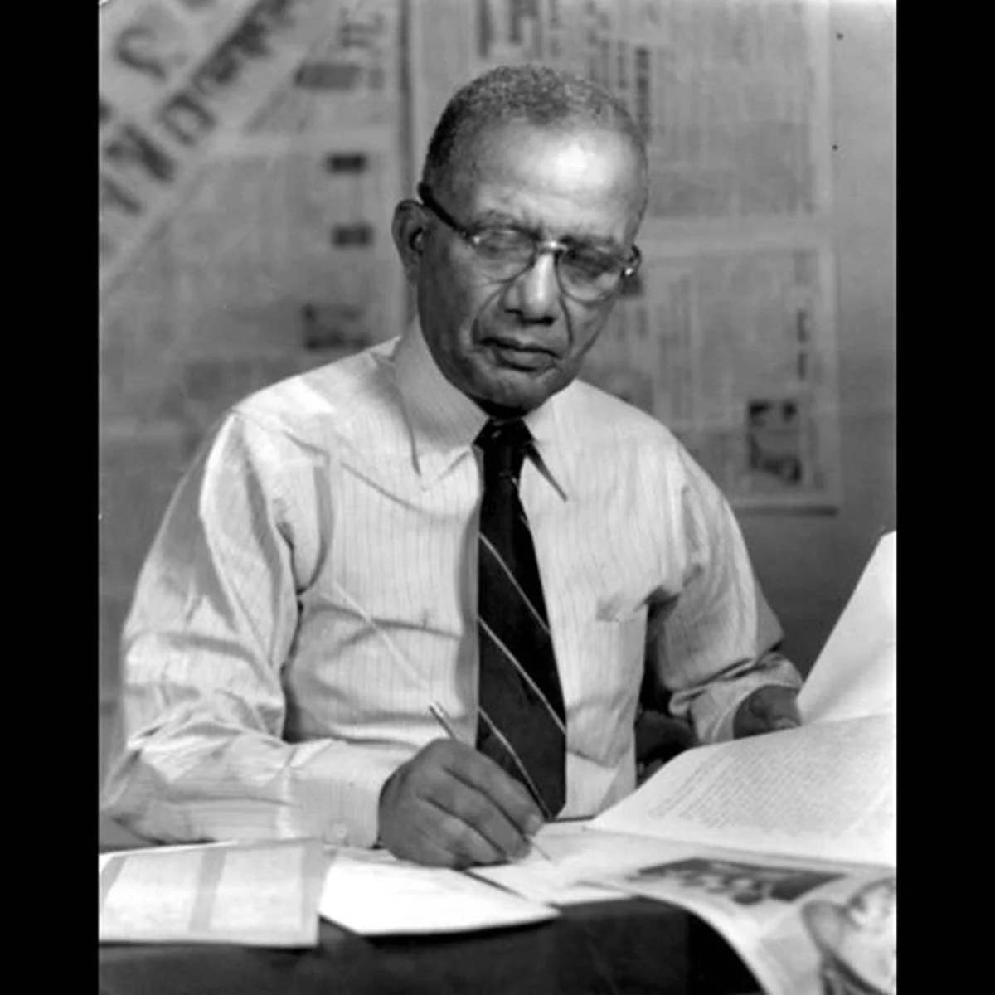
AJ Smitherman
AJ Smitherman was a press pioneer who created a Black newspaper called the Tulsa Star.
Smitherman used the newspaper to empower Black residents
He encouraged Black residents to support Black businesses and aimed to uplift the Black community
Notes:
AJ Smitherman created a Black Newspaper called the Tulsa Star – used the newspaper to empower Black residents
Smitherman also encoruaged the Black residents to support Black owned businesses in Greenwood - he believed education was important to upift the Black community

Slide 10
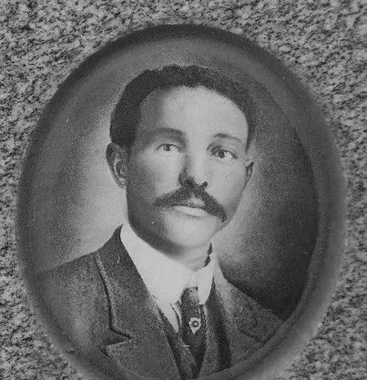
Dr. AC Jackson
Dr. Jackson was considered the most able Black surgeon in America.
Dr. Jackson specialized in chronic diseases and surgery for women.
Some of the surgical tools Dr. Jackson invented are still in use today.

Slide 11
Reflection
Had you ever heard of Black Wall Street before?
If not, why do you think that is?

Slide 12

Break
Teacher, this is a natural spot to offer a break, or resume the lesson during your next class session.
Notes:
Much of the information on the following slides was taken from: https://www.tulsahistory.org/exhibit/1921-tulsa-race-massacre/

Slide 13
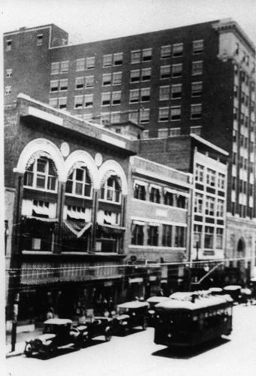
The Elevator Ride
On the morning of May 30th, 1921 a young Black man named Dick Rowland was accused of assault while riding in an elevator with a white woman named Sarah Page.
Accounts of the incident circulated among the white community and became more exaggerated with each telling.
Rowland was arrested and an investigation began.

Slide 14
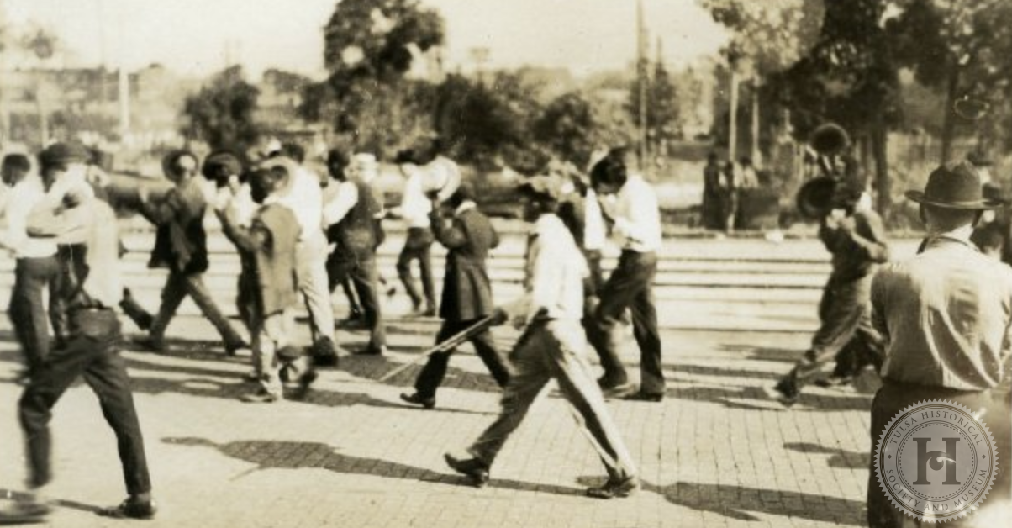
Black and White Mobs
There was a confrontation on May 31st between a Black mob and a white mob outside the courthouse.
The sheriff and his men barricaded the top floor to protect Rowland.
Shots were fired, the Black folks retreated to the Greenwood District.

Slide 15
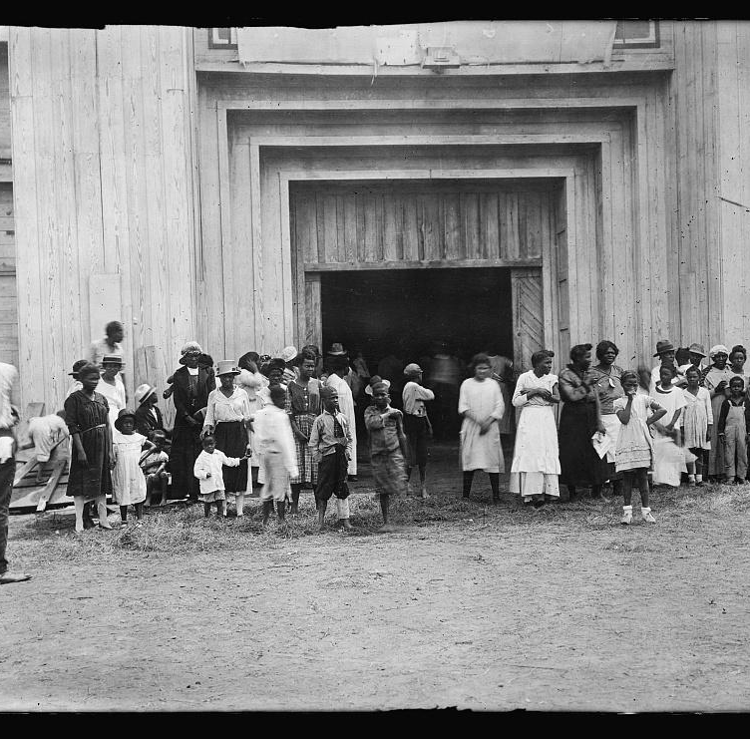
Riot & Captives
In the early morning of June 1, 1921 the Greenwood District was looted and burned by white rioters.
Deputized white civilians had imprisoned Black Tulsans.
The Governor declared martial law and the National Guard was summoned.
Over 6,000 people were held for as long as 8 days.

Slide 16
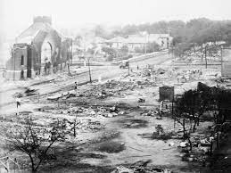
Black Wall Street in Ruins
Thirty five city blocks lay in charred ruins
More than 800 people were treated for injuries
Historians believe as many as 300 people may have died

Slide 17
Reflection
Did you learn about the Tulsa Race Riot in history class?
If not, why do you think that is?

Slide 18
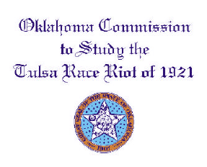
Commission
In 2001 an official Race Riot Commission was organized to review the details of the event.
Among other things, the commission recognized the government's responsibility for riot.
"Despite duties to preserve order and to protect property, no government at any level offered adequate resistance, if any at all, to what amounted to the destruction of the Greenwood neighborhood."

Slide 19
Reflection
The Tulsa Race Riot occurred in 1921.
The Oklahoma Commission that reviewed the event was formed in 2001.
Why do you think it took so long?

Slide 20
Check Out
How do you take care of yourself?
Read
Art
Exercise
Watch
Write in a journal
Other

Slide 21

Human Relations, Diversity & Equity

Slide 22
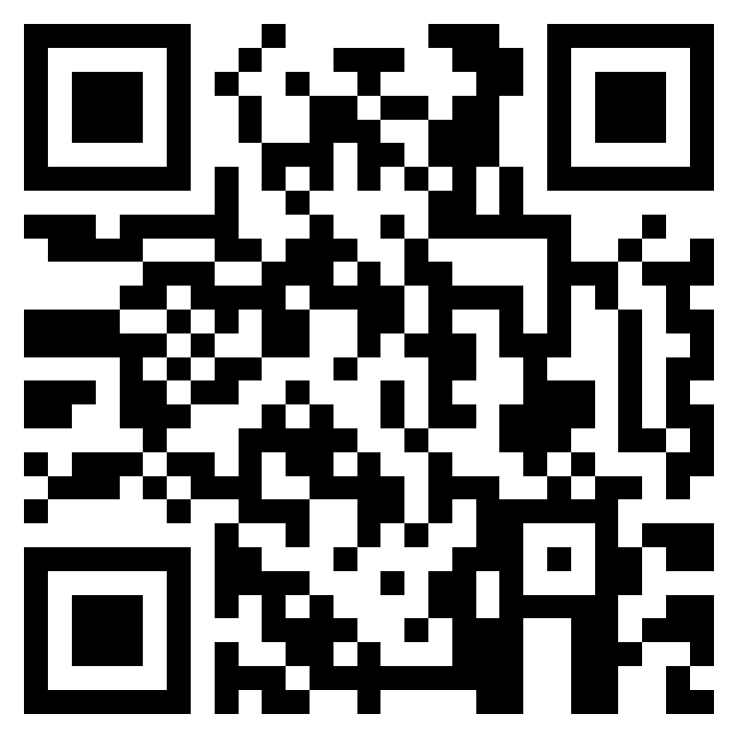
Teacher Feedback
Notes:
Teacher, please complete a brief feedback survey by scanning the QR code or using the link below
https://forms.office.com/r/i9UqyyxzTT

